Slide 1
Specialized producer of bee food and supplements

Slide 2
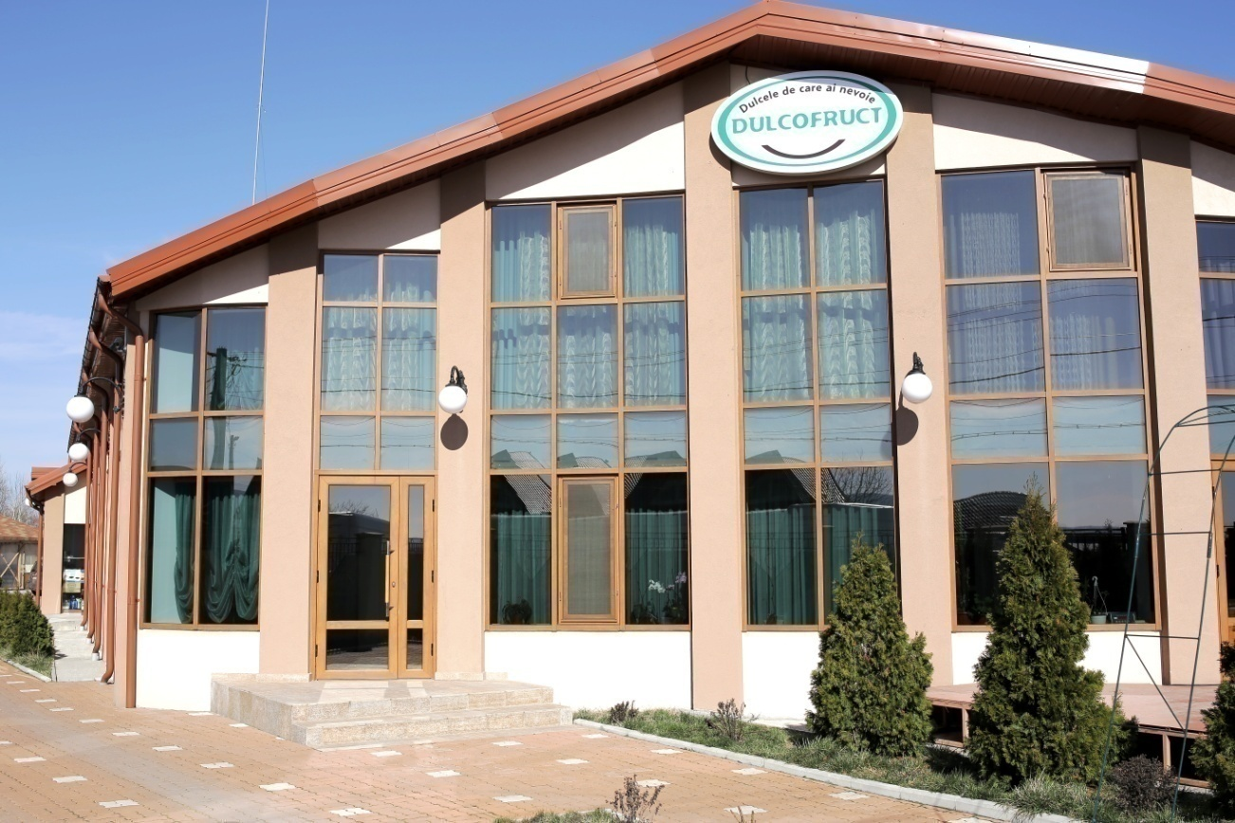
content
I. History
II. Liquid food
III. Solid food
IV. Biostimulators

Slide 3
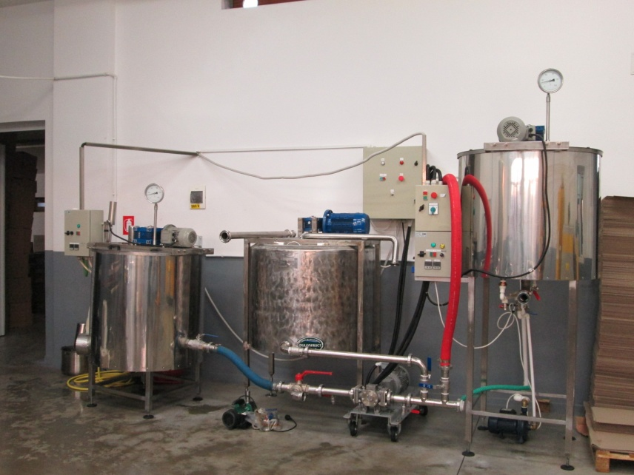
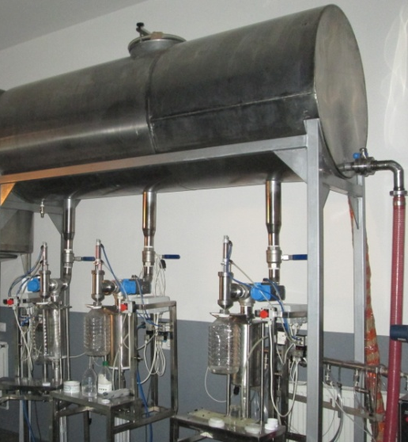
I. History of the company
The company SC CIRAST SRL was founded in the year of 2001, and starting from 2009 the company has focused its activity in the beekeeping area, creating the “DULCOFRUCT” brand, a name that resembles in present with professionalism, seriousness, high work flow and mutual prosperity.
SC CIRAST SRL is a specialized bee food and supplements producer, having a factory with the latest technologies of producing – processing – checking – packaging of the final products having qualified personnel and respecting all the safety regulations.

Slide 4
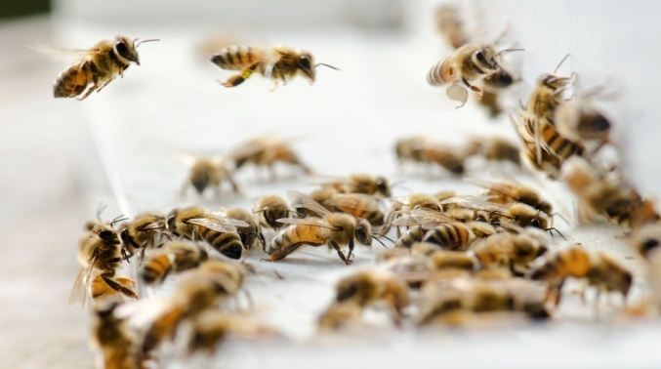
Today, the company with the headquarters in Golestii de Sus, Vrancea County, Romania, offers the beekeepers a new opportunity for developing their activity, rising their margin and minimizing the risks.
We stand on 3 values: change, integrity and mutual prosperity, and in all that we do, at the core of our business we share the love for bees.

Slide 5
MANAGEMENT
Our team is build up from 30 people forming specialized departments of:
Accounting;
Marketing and Sales;
Production;
Research and logistics.
So that all of our products can be assisted correctly and completely from the design, production and finally to consumption.

Slide 6
Research
The Cirast-Dulcofruct company has various partnerships with:
University of Agricultural Sciences and Veterinary Medicine of Banat "King Mihai I of Romania" from Timisoara, Dr. NarcisaMederle - Measures for prevention, control and control in parasitic diseases of bees;
Dr. M.V. Cristian Daniel Popovici - Bee Nutrition;
National Institute for Research and Development ICECHIM;
Various renowned beekeepers in the country and abroad

Slide 7
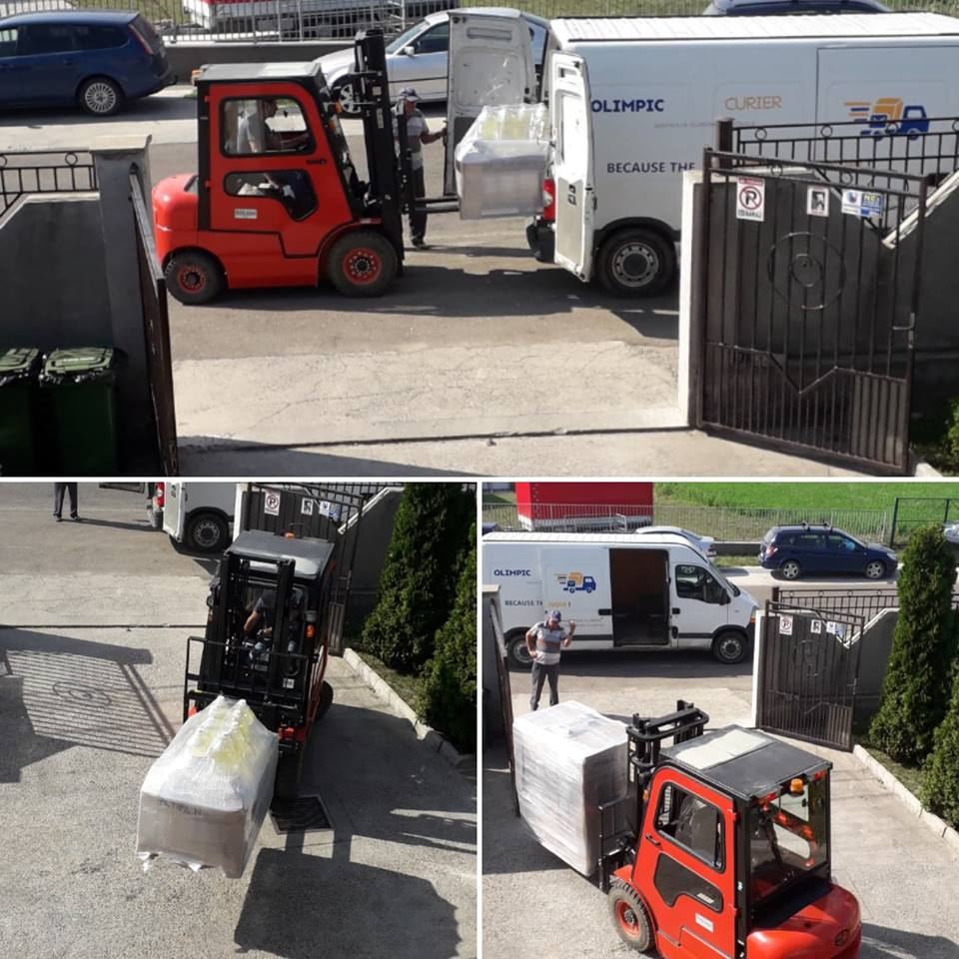
Activities
We are producing and distributing the whole aggregate of bee food and supplements, we own an entire versatile portfolio that is easy adaptable for all of the melliferous areas.
We have over 70 partnership stores in Romania that assures us an important market share, numbers that puts us as a leader in this business.
Our company has its own fleet and advantageous contracts with specialized logistics companies so we can assure full services for our customers.

Slide 8
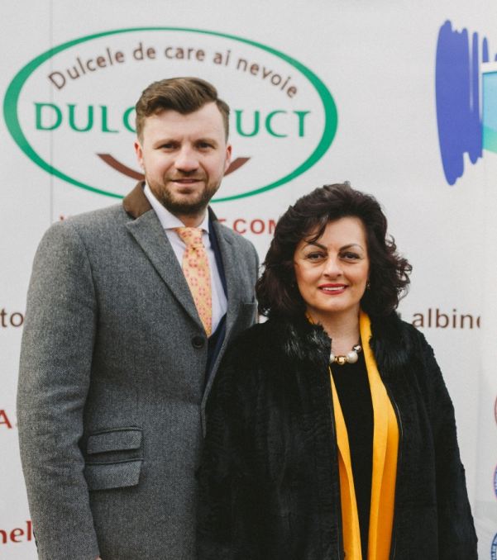
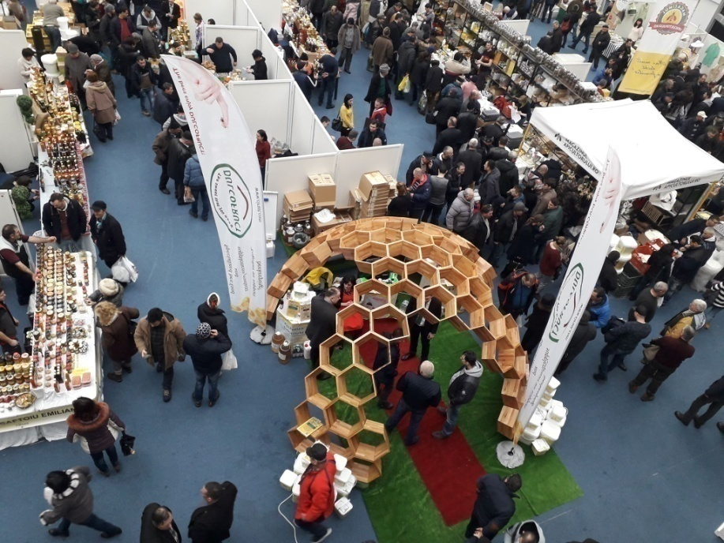
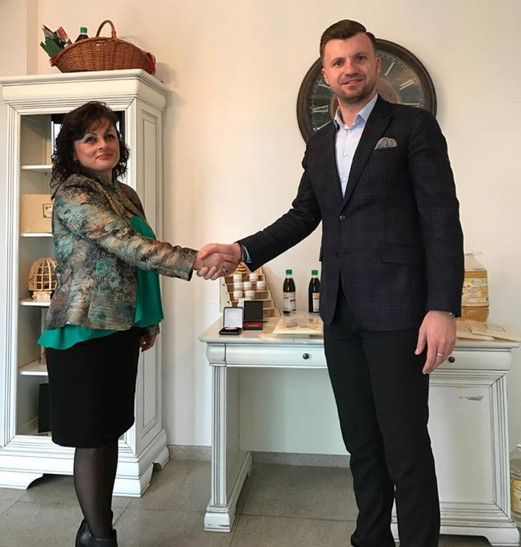
Since 2010 we are welcoming the beekeepers, participating at all of the beekeeping fairs all around the country and abroad sharing with them the beekeeping trades.
In 2017 we were present at the highest scene of worldwide beekeeping APIMONDIA Istanbul 2017.
The Cirast-Dulcofruct is up to date with useful information, suggestions, new products and beekeeping events.

Slide 9
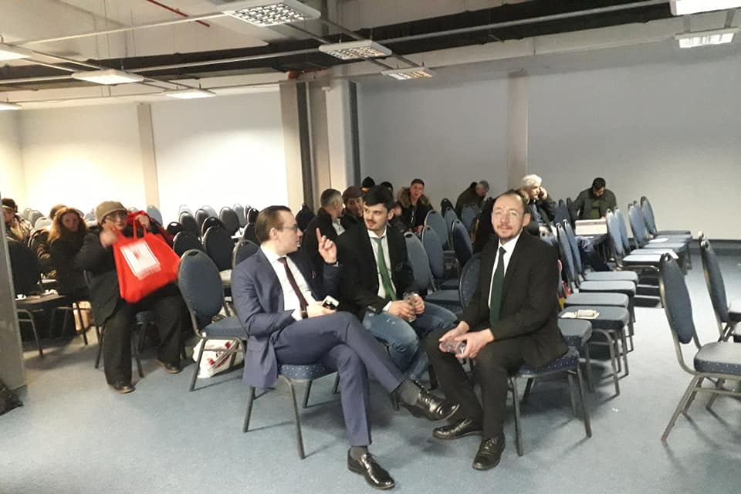
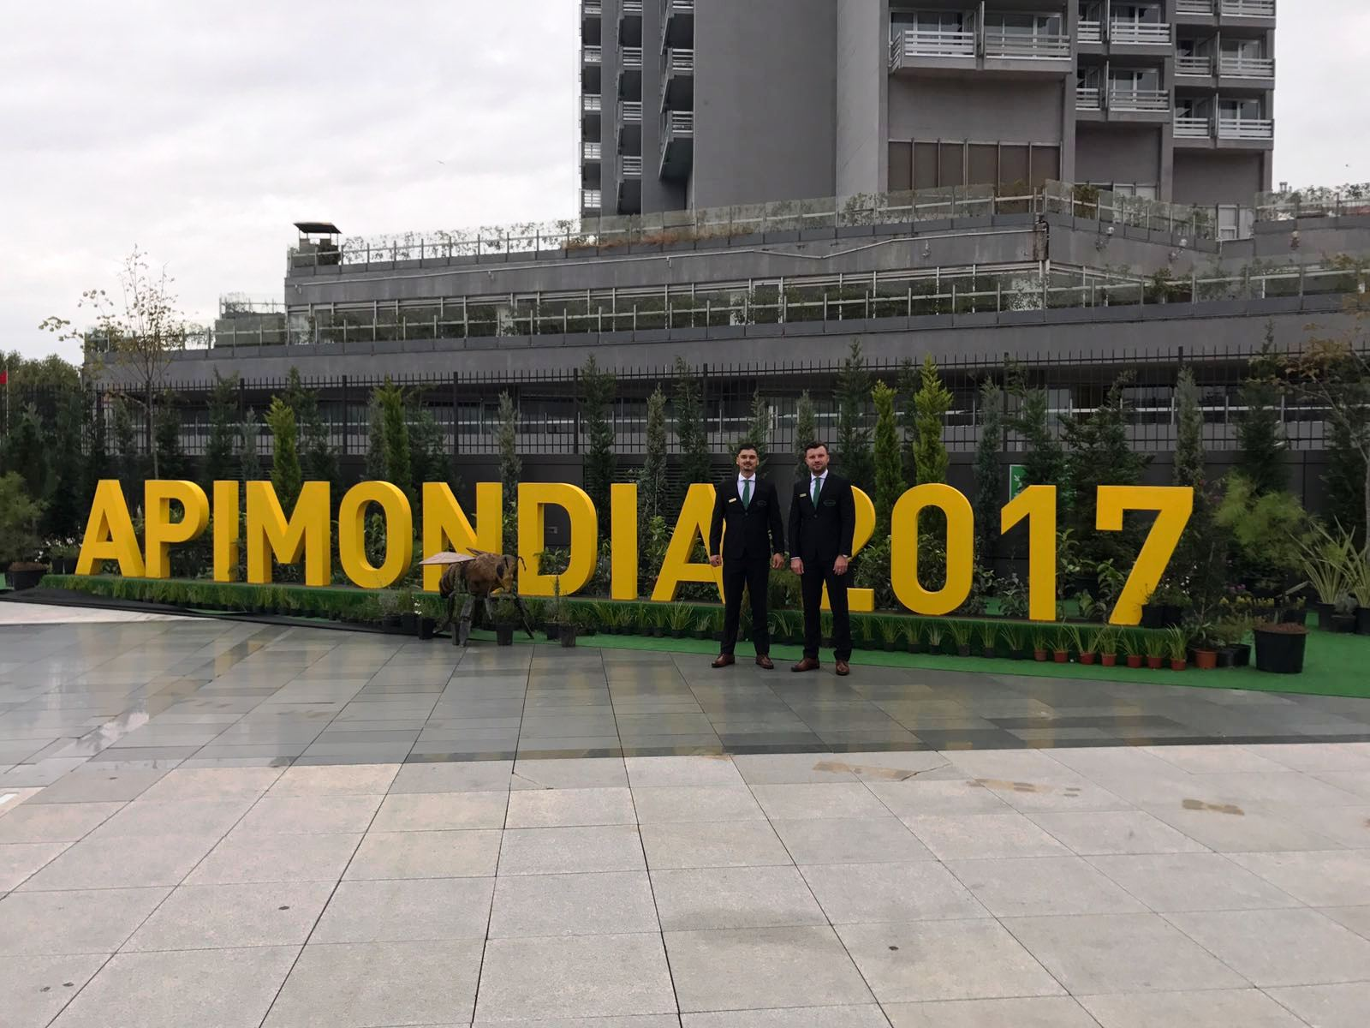
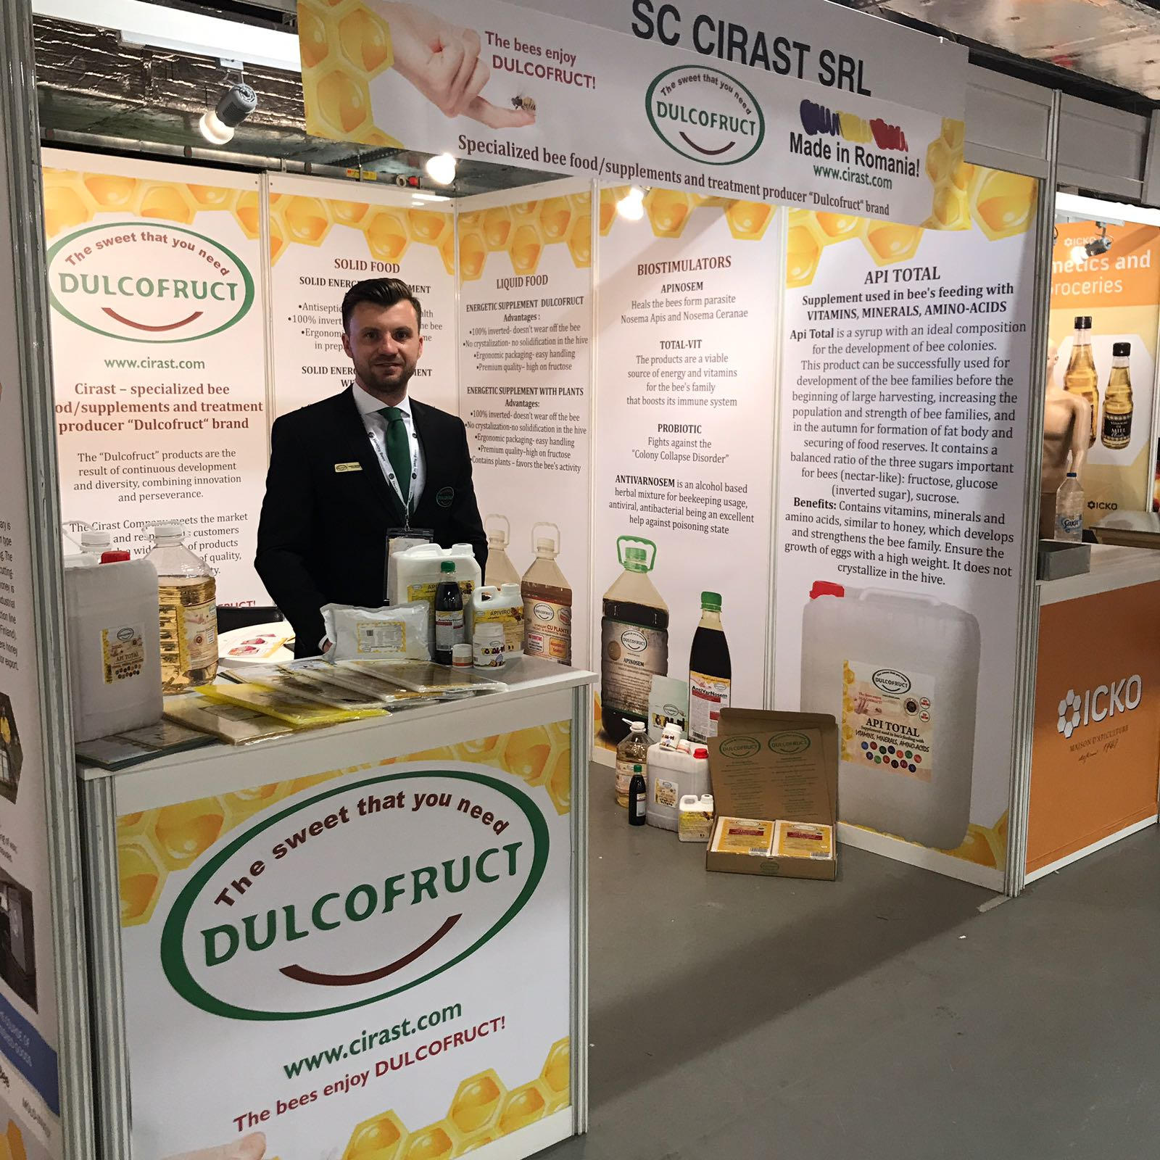
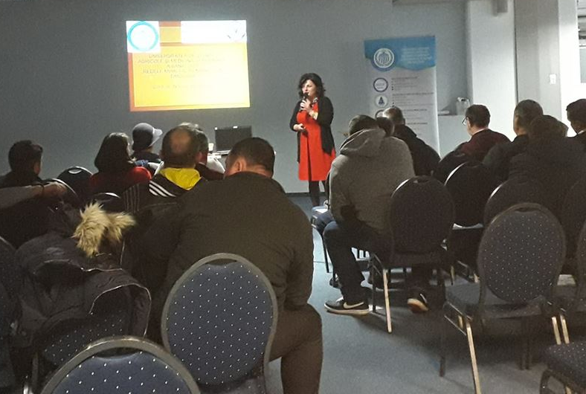

Slide 10
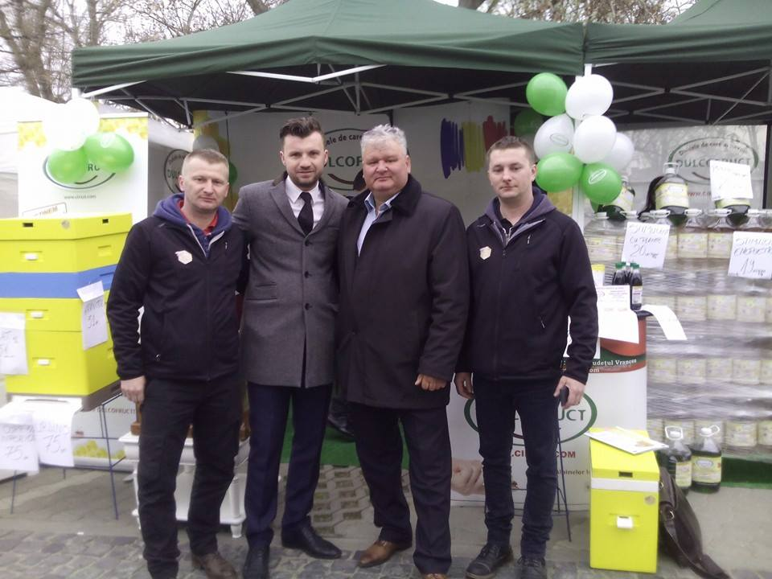
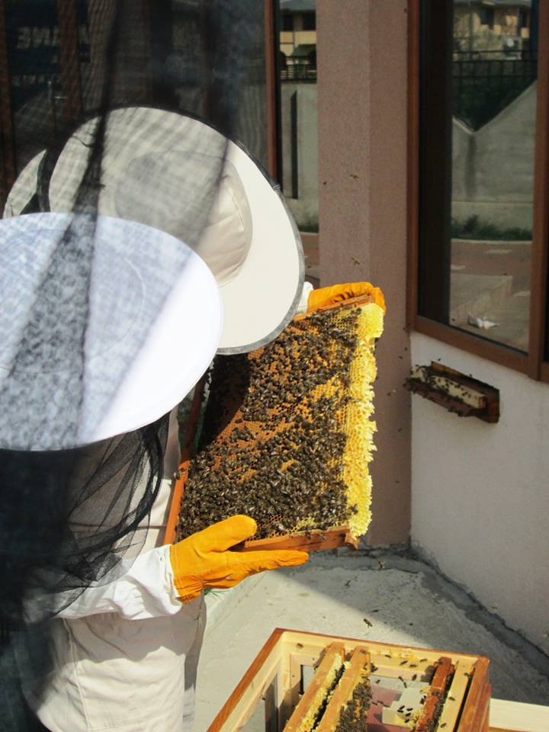
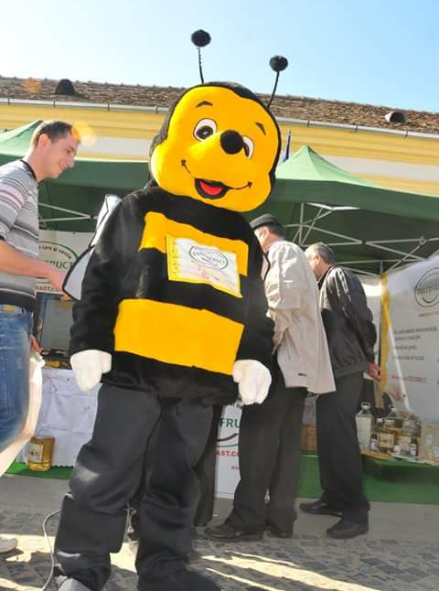
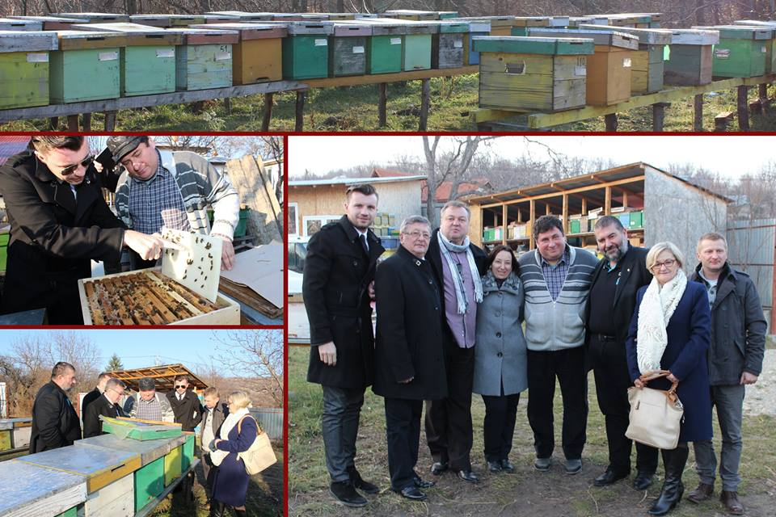

Slide 11
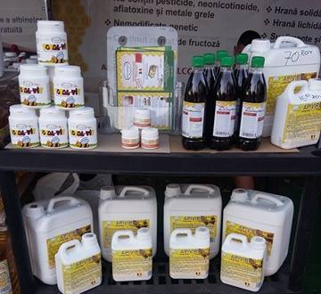
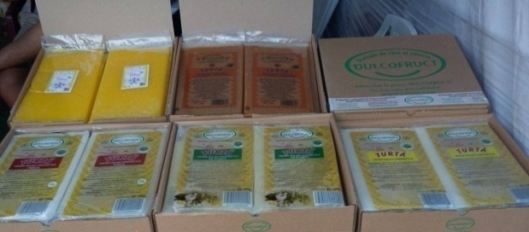
partnerships
We want to launch on the market products with the highest quality standards by combining innovation and perseverance at prices and advantageous conditions to respond better to our customer’s highest requests.
We intend to develop our partnerships with our collaborators providing our products all around the country.
By participating to the beekeeping fairs we are constantly sharing our knowledge with the passionate beekeepers, listening to their opinions and oferring the best feeding solution.
We are present on the European Market; our company has developed numerous partnerships with:
United Kingdom: local distributorMaisemore Apiaries, bees-online.co.uk
Lithuania: local distributorBitè Tuk, bitetuk.lt
Poland: local distributorBabik-Sabat, firmababik.pl
France: local distributorProvence Apiculture, provence-apiculture.fr
Portugal: local distributorApiSantos, apisantos.com
Italy: local distributorConsorzio con le api, consorzioconleapi.it
Spain: local distributorSistemas Writer 400, sw400.es
Hungary : local distributorOrosker, dulcofruct.hu
Bulgaria: local distributorПчелна ферма Ели-Яна ЕООД (Pchelnaferma Eli-YAna EOOD)
Republic of Moldova: local distributorInterSIS-45SRL, facebook.com/dulcofruct.hu
Ukraine: local distributorBirotix, esca.com.ua
Greece: local distributorDulcofruct Greece, facebook.com/dulcofructgreece
Albania: local distributor:ExpressPharma, expresspharma-al.com
By choosing Dulcofruct, you have the certainty that you have chosen the most effective solution for feeding your bees.
In 2022, we intend to become the largest bee producer and bee supplements.

Slide 12
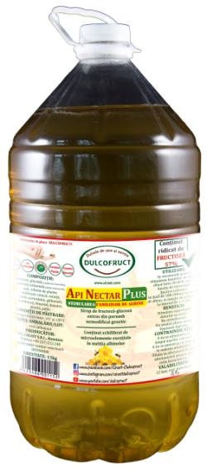
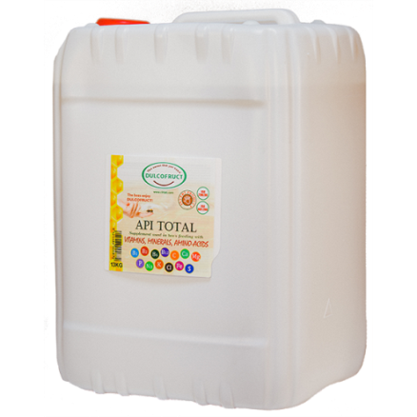
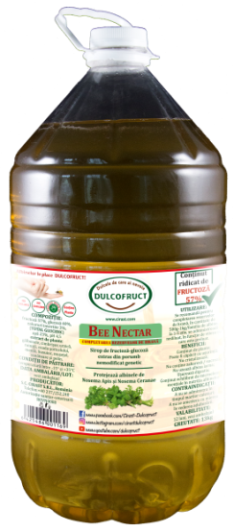
II. Liquid food for bees
For STIMULATION
– recommended in the spring:
ApiTotal;
ApiNectar Plus
For COMPLETING food reserves
– recommended in the winter:
BeeNectar;
ApiNectar.
Note:
ApiTotal alongside with Apinectar Plus are destined for stimulating the growth of larvae in the active season.
ApiNectar and BeeNectar are destined for feeding the bees for completing the food reserves in winter.

Slide 13
APItotal - stimulation
ApiTotal is syrup with an ideal composition for the development of bee colonies.
Ingredients: fructose, glucose, sucrose, water, excipients, vitamins: B1, B2, B5, B6, B7, B12, C, and PP; minerals: Ca, Mg, P, Na, K, Cl, Fe, S; amino acids: Tryptophan (L), Methionine (DL), Lysine (L), polyphenols and herbal tannins (artichokes, thyme, shrimp, marigold, basil).
Usage: STIMULATION:
Dilute the product with 20-25% water (distilled). It is applied in the feeder or can be sprayed onto the frames: 250 g - 300 g once every 2-3 days depending on the power of the bee family.
Daily capacity: 12 tons
Shelf life: 12 months
Logistics details: 13kg jerry can, 60pcs / pallet

Slide 14
APINECTAR PLUS - stimulation
Apinectar Plus is fructose-glucose syrup that is extracted from NON-GMO corn recommended for stimulating the bee families.
Ingredients: fructose, glucose (invert sugars), sucrose / sucrose (uninverted sugar), water, herb infusion: thyme, nettle, rhubarb, yolk, marigold, St. John's wort, basil, mint, wormwood.
Usage: It is recommended to stimulate bee families, diluted between 30-80% water, depending on the technology of each user, at a dose of 100-300 ml / day / bee family, depending on its strength, at 1-3 days.
Daily capacity: 12 tons
Shelf life: 12 months
Logistics details: 13kg PET, 54pcs / pallet.

Slide 15
BEE NECTAR - Completing food reserves
BeeNectar is syrup designed to supplement food supplies that protect the bee family against NosemaApis and NosemaCeranae.
Ingredients: fructose, glucose, inverted sugars (total carbohydrate), water, plant extract: thyme, nettle, prawn, quince, marigold, St. John's wort, chamomile, basil, mint, wormwood.
Usage: Administer in a quantity of 500gr.-1kg / bee family, 1-5 days, undiluted, depending on the rate at which it is taken.
Daily capacity: 12 tons
Shelf life: 12 months
Logistics details: 13kg PET, 54pcs / pallet

Slide 16
Apinectar - Completing food reserves
ApiNectar is syrup designed to supplement food supplies with a balanced content of essential microelements in bee nutrition.
Ingredients: fructose, glucose, invert sugars (total carbohydrate), water
Usage: Administer in a quantity of 500gr.-1kg / bee family, 1-5 days, undiluted, depending on the rate at which it is taken.
Daily capacity: 12 tons
Shelf life: 12 months
Logistics details: 13kg PET, 54pcs / pallet

Slide 17
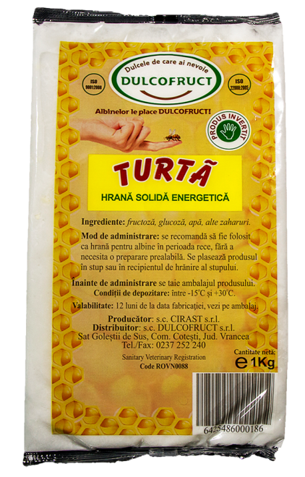
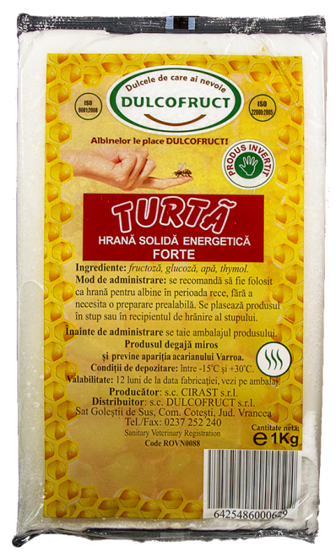
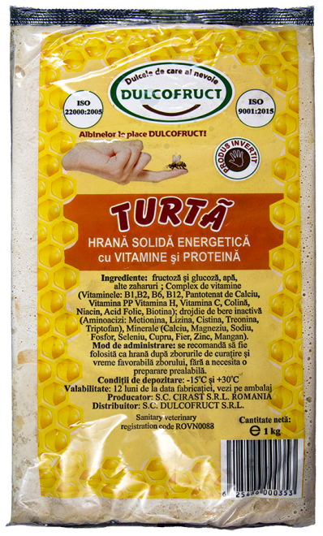
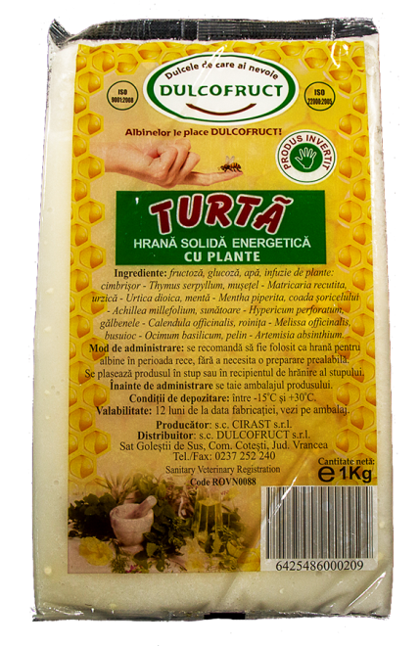
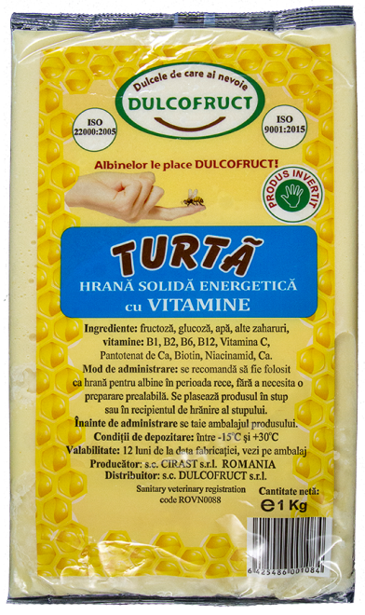
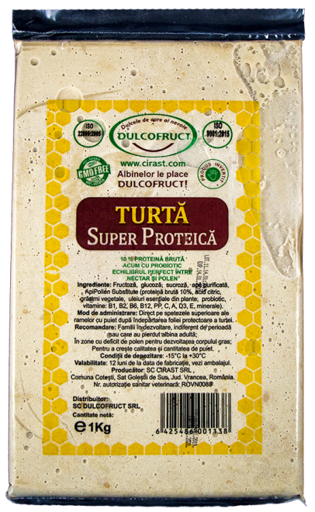
III. Solid food for bees
Energetic cake;
Energetic cake with Plants;
Energetic cake Forte (Thymol);
Energetic cake with Vitamins;
Energetic cake with Vitamins and Proteins;
Super Protein cake

Slide 18
Energetic cake
Energetic Cake is a unique, complex product that gives the bee family multiple benefits, ensuring the best wintering.
Ingredients: fructose, glucose, sugars, microelements needed for the bee.
Usage: Cut the packaging and place the product in the hive.
Benefits of using the product:
100% invert product - does not wear bees,
creamy consistency - easy assimilation
ergonomic packaging - favors easy handling
Low pH - reduces the appearance of nosemosis
Daily capacity: 15 tons
Shelf life: 12 months
Logistics details: 1kg plastic bag / foil, 1.000 pcs / pallet

Slide 19
Energetic cake with plants
Energetic cake with Plants is a unique, complex product with beneficial effects of natural plants. It is a natural antibiotic with prophylactic effect and treatment against NosemaApis and NosemaCeranae.
Ingredients: fructose, glucose, sugars, microelements needed for bee, water, infusion of plants: thyme, nettle, prawn, muzzle, marigold, St. John's wort, chamomile, basil, mint, wormwood.
Usage: Cut the packaging and place the product in the hive.
Benefits of using the product:
100% invert product - does not wear bees,
creamy consistency - easy assimilation
ergonomic packaging - favors easy handling
Low pH - reduces the appearance of nosemosis
Daily capacity: 15 tons
Shelf life: 12 months
Logistics details: 1kg plastic bag / foil, 1.000 pcs / pallet

Slide 20
Energetic cake FORTE (with Thymol)
Energetic cake FORTE is a product that has the active substance Thymol.
This substance gradually removes odor in the hive, keeping away theVarroa mite, and once it arrives in the bee's digestive tube, it makes winter easier.
Ingredients: fructose, glucose, sugars, microelements needed for bee, thymol.
Usage: Cut the packaging and place the product in the hive.
Benefits of using the product:
contains thymol - helps the bee fight the Varroa mite
100% invert product - does not wear bees,
creamy consistency - easy assimilation
antiseptic content - strengthens the bee's immune system
Daily capacity: 15 tons
Shelf life: 12 months
Logistics details: 1kg plastic bag / foil, 1.000 pcs / pallet

Slide 21
Energetic cake with vitamins
Energetic cake with Vitamins is ideal to provide extra food during the cold season.
Ingredients: fructose, glucose, sugars, micro-nutrients needed for bees, vitamins: B1, B2, B5, B6, B7, B12, C and PP.
Usage: Cut the packaging and place the product in the hive.
Benefits of using the product:
the vitaminisation of bees - the high-stimulation of the queen's brood
100% invert product - does not wear bees,
creamy consistency - does not flow through the frames
aseptic content - strengthens the bee's immune system
Daily capacity: 15 tons
Shelf life: 12 months
Logistics details: 1kg plastic bag / foil, 1.000 pcs / pallet

Slide 22
Energetic cake with vitamins and proteins
Energetic cake with vitamins and proteins is a feeding product that has to be taken after cleansing flights.
Ingredients: fructose, glucose, sugars, micro-nutrients needed for bees, vitamins: B1, B2, B5, B6, B7, B12, C, PP, amino acids: methionine, lysine, cysteine, thionine, tryptophan; minerals: Ca, Mg, P, Na, Cu, Zn, Fe, Mg, Se.
Usage: Cut the packaging and place the product in the hive.
Benefits of using the product:
contains thymol - helps the bee fight the Varroa mite
100% invert product - does not wear bees,
creamy consistency - easy assimilation
antiseptic content - strengthens the bee's immune system
Daily capacity: 15 tons
Shelf life: 12 months
Logistics details: 1kg plastic bag / foil, 1.000 pcs / pallet

Slide 23
Super Protein Cake
Super Protein Cake is the top-of-the-line, perfectly balanced carbohydrate, but also with enhanced protein content that ensures the explosive development of the colony.
Ingredients: fructose, glucose, sucrose, bee microelements required, purified water, ApiPollen Substitutes (crude protein 10.5%, citric acid, vegetable fats, essential oils in plants, probiotics, vitamins B1, B2, B6, PP, A, D3, E, minerals: Ca, Mg, P, Na, Cu, Zn, Fe, Mg, Se.
Usage: Cut the packaging and place the product in the hive
Benefits of using the product:
perfect balance of carbohydrates, vitamins, minerals, probiotic
stimulation and fat body formation
100% invert product –doesn’t wear off the bee, can be used in the
absence of pollen and nectar in nature
creamy consistency - does not flow onto the frames
antiseptic content - strengthens the bee's immune system
Daily capacity: 15 tons
Shelf life: 12 months
Logistics details: 1kg plastic bag / foil, 1,000 pcs / pallet

Slide 24
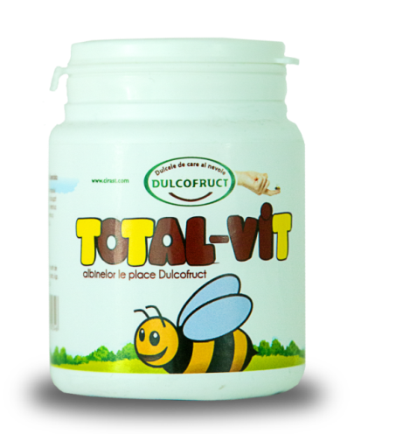
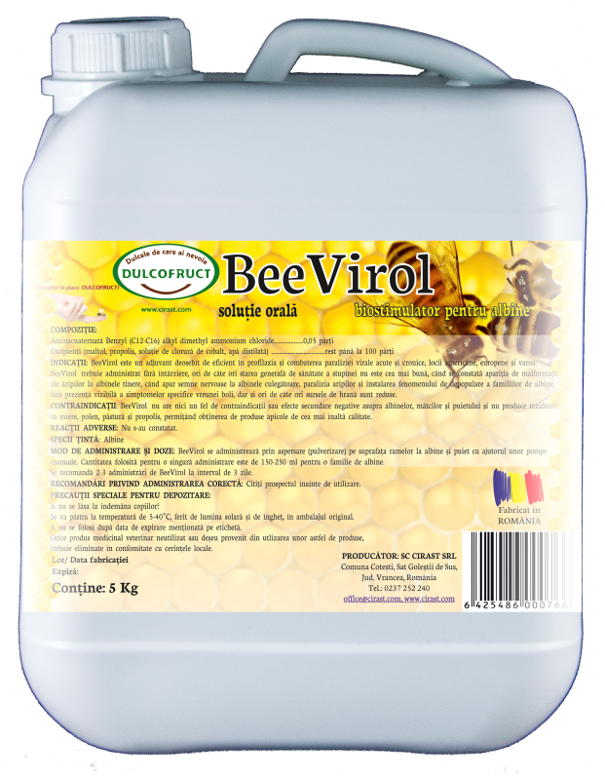
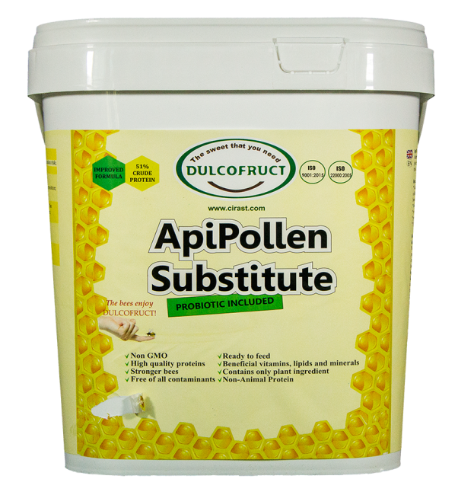
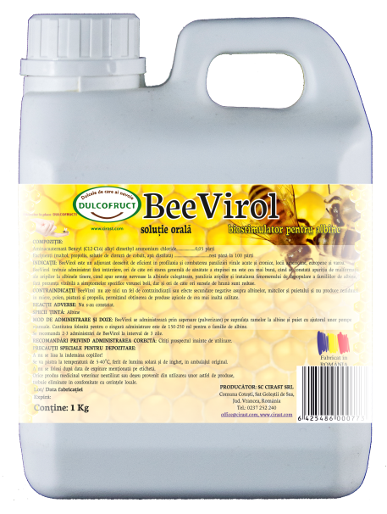
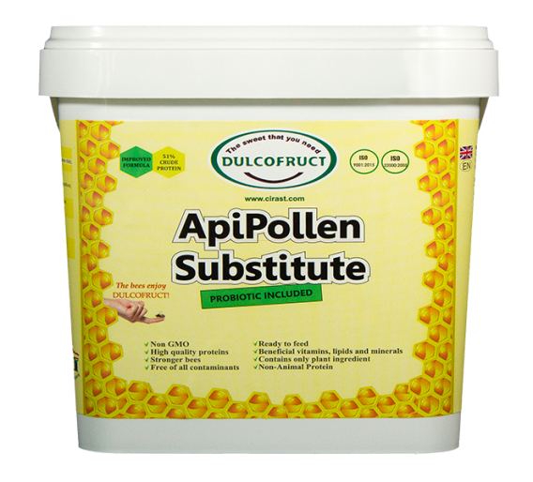
iv. Biostimulators
ApiPollen Substitute
AntiVarNosem
Total-Vit
BeeVirol

Slide 25
ApiPollen SUBSTITUTE
ApiPollen Substitutes is a pollen substitute with high biological value.
It contains a large amount of protein 51%, well balanced with the essential amino acids essential to bees, easily digestible and digestible.
Ingredients: soy protein and yeast, vitamins: B1, B2, B6, B12, PP, C, A, D3, E, mineral complex, citric acid, vegetable fats, essential oils, probiotics.
Ussage :
ApiPollenSubstitute powder state:
Place the product in a recipient with holes through which the bees can move, provided with a few pieces of wood or anti-skidding material to help them flee. Administer approx. 700gr. ApiPollen powder/ Bee family substitutes, keeping the product from wind and moisture.
It is recommended to use special feeders for pollen replacement.

Slide 26
ApiPollenSubstitute mixed with carbohydrates:
CAKES: Mix 200g. ApiPollen Substitutes / 800gr. carbohydrates (various combinations of honey, HFCS, sugar) at temperatures up to 40° C, paste consistency applied in waxed paper bags or plastic ones, on the upper rays of the frames.
SYRUP: Mix 100g. ApiPollen Substitutes / 1litre of syrup (Apinectar), sugar, HFCS, will be used in stimulating syrup with a 50% dry substance concentration, administered in the feeder.
Shelf life: 12 months
Logistics details: bucket 2kg, bucket 8kg

Slide 27
Antivarnosem
AntiVarNosem is an herbal alcoholic macerate containing essential plants for beekeeping usage, antiviral, antibacterial use, an excellent poison control adjuvant to prevent infestation with Varroa and Nosema.
Ingredients: herbal extract: chamomile, marigold, St. John's wort, mint, mite, dandelion, nettle, wormwood, thyme, basil; essential oil of lavender and fennel; purified water; ethyl alcohol; propolis. Ussage :
In syrup: prevention: 15ml / kg, treatment: 20ml / kg
In solid food: 30ml / kg, treatment: 40ml / kg
Monthly capacity: 4,000 tons
Shelf life: 12 months
Logistics details: 500gr. PET, 864 pcs / pallets

Slide 28
Total-Vit
Total-Vit is a mix of vitamins and minerals, presented as an orange powder.
An excellent stimulant for the queen’s brood, which provides colony regeneration when the intake of vitamins is low.
Ingredients: vitamin complex: B1, B2, B6, B12, PP, H, C, Ca, pantothenate, glucose, pure fructose, water.
Ussage :
1g Total-Vit - 1kg Dulcofruct syrup
1gr Total-Vit - 1kg Dulcofruct cake
Monthly capacity: 4,000 tons
Shelf life: 12 months
Logistics details: 100gr. PET

Slide 29
Beevirol
BeeVirol is a strong biostimulator for bees.
Ingredients: excipients: malthol, propolis, cobalt chloride solution, distilled water, and aminocarboxylic acid.
Ussage :
It is administered by spraying on bee and queen’s brood with hand pumps. The amount used for a single administration is 150-250ml for bee family, 2-3 administrationsat 3 days.
Monthly capacity: 10,000 liters / month
Shelf life: 12 months
Logistics details:
1 L / plastic bottle / 600pcs / pallet
5 L / plastic bottle / 40pcs / pallet

Slide 30
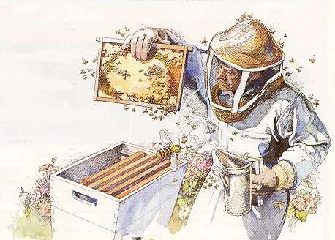
Dulcofruct has combined innovation with traditional practices and managed to create a fusion between the elements of nature and modern technology, launching the perfect bee feeding solution.
The bees enjoy Dulcofruct!
Together we support beekeeping!
Thank you for your attention

